Slide 2
BBM384 Software Engineering Laboratory
Sports Center Membership System (SCMS)
Application Type: Web-based
No:12 & Name: Tesla
Team Members:
Specialized Team Role | Student No | Student Name | Student Surname
Software Project Manager | 21526662 | Veli Can | AYDIN
Software Analyst | 21387485 | Onur | VARSAK
Software Architect | 21427033 | Abdülsamet | KALKAN
Software Configuration Manager | 21483421 | Sefa Seyda | ÖZDOĞAN
Software Tester | 21426993 | Hakan | İMAL
Software Quality Manager | 21590911 | Barkın | ATASAY

Slide 3
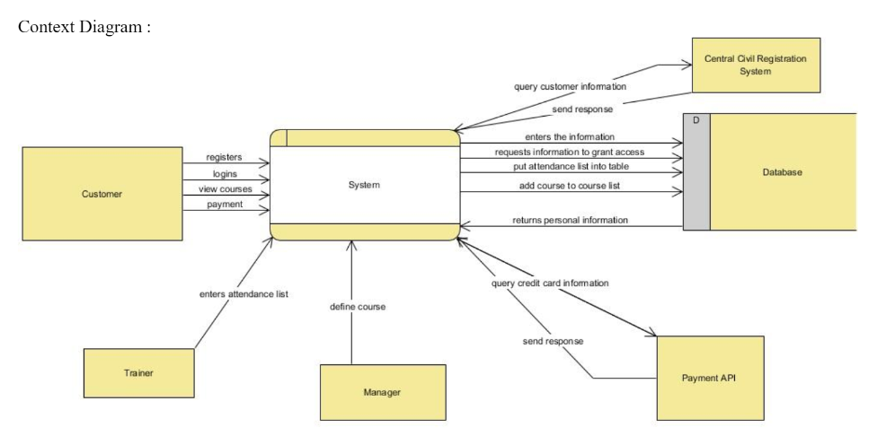
Project Context

Slide 4
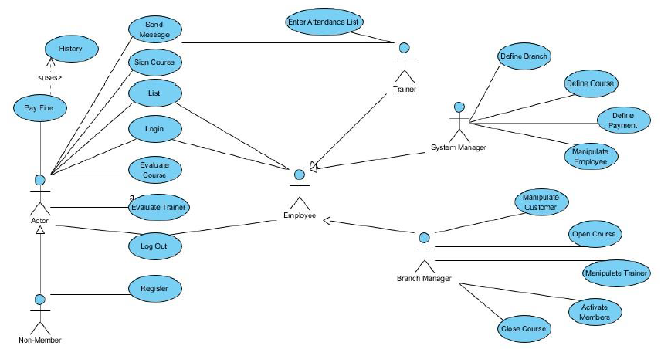
Functional Software Requirements

Slide 5
Non-Functional Software Requirements
Non-Functional Software Requirements
Usability:
Prioritize the important functions of the system based on usage patterns. Frequently used functions tested for usability, as should complex and critical functions.
Reliability:
Users have to trust the system, even after using it for a long time. Your goal should be a long MTBF (mean time between failures). Create a requirement that data created in the system will be retained for a number of years without the data being changed by the system. It’s a good idea to also include requirements that make it easier to monitor system performance.
Performance:
What should system response times be, as measured from any point, under what circumstances? Are there specific peak times when the load on the system will be unusually high? Think of stress periods, for example, at the end of the month or in conjunction with payroll disbursement.
Supportability:
The system needs to be cost-effective to maintain. Maintainability requirements may cover diverse levels of documentation, such as system documentation, as well as test documentation, e.g. which test cases and test plans will accompany the system.

Slide 6
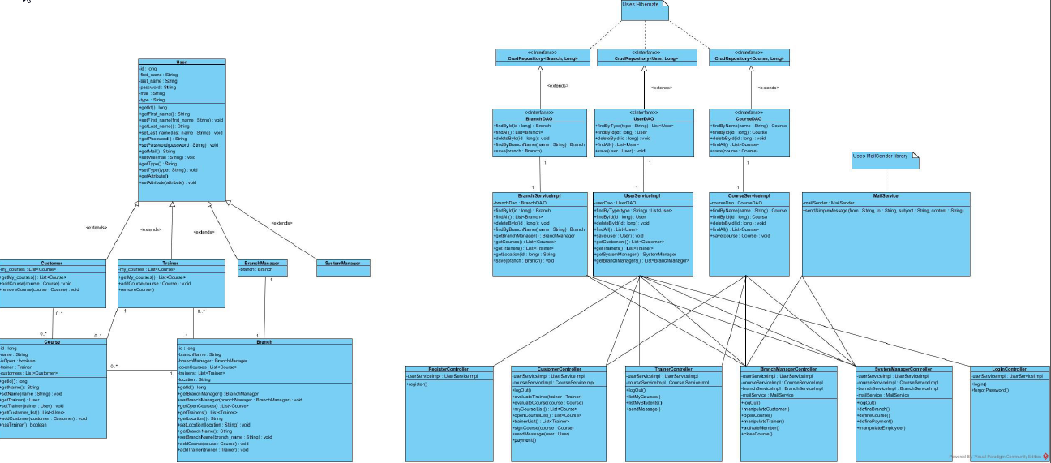
Software Architecture

Slide 7
Technological Background
Overview of technology we have used:
JAVA Spring Framework,Hibernate,Thymeleaf
CSS, Javascript and HTML
MySQL Database Management System

Slide 8
Final Project Demo
We will run the most recent version of our product now.

Slide 9
Work Allocation
We allocated the work according to the role of the members.Especially, our manager told us what to do and every member have done it successfully.In addition everyone has contributed to development of the Project.

Slide 10
Software Project Manager
21526662 / Veli Can Aydın
Set the platform and standards for the project to be codded
Code distribution and assembly
Task sharing
I created a panel for System Manager in other words I have done the implementation of SystemManagerController.

Slide 11
Software Analyst
21387485 / Onur Varsak
Software Analyst,Analyzed the risks that could occur while doing the project and produced the necessary solutions
Risk management reports
Use case diagram, Context diagrams
I created the infrasturcture to make data transfer from database by using hibernate technology.

Slide 12
Software Architecture
21427033 / Abdülsamet Kalkan
I checked the compatibility between the design and code written.
Checked the sections on the design in the reports
Draw Sequence, Activity diagrams, Class Diagrams
I have done the front-end part of the project with Barkın.I contributed to some of the parts of the back –end section too.

Slide 13
Software Configuration Manager
21483421 / Sefa Seyda Özdoğan
Software Configuration Manager
Checked the people in the group to see if they did their duties.
Draws Use Case, Context Diagrams
Decided on the changes to be made
I created a panel for Customer Manager and done the implementation of ‘register’.

Slide 14
Software Tester
21426993 / Hakan İmal
Software Tester
I checked the working and non-working parts of the system.
I found many errors and reported them. I proposed changes according to bugs that I found.
I created a panel on server side for Branch Manager and I also implemented the ‘login’.

Slide 15
Software Quality Manager
21590911 / Barkın Atasay
Software Quality Manager
Aims to develop and manage the quality of software so the product meets the requirements
At most I was interested in front-end part.I have done HTML,CSS files and by using Thymeleaf I did the display of the information on the screen comes from the server.

Slide 16
Self-Evaluation of Project Development
We consider our software succesful because we think that we meet the reqirements. In additiin, according to the test results, we see that it is a succesful product.
We would do the same except the design of the Project.

Slide 17
Thank You!
Any questions..?

Slide 18
References
http://hibernate.org/
https://spring.io/
https://www.thymeleaf.org/

